Slide 1
CSE 321
Real Time and Embedded Operating Systems
Project 3, Fall 2022
Joseph Yang

Slide 2
Table of Contents
Introduction
Project Overview
Internal Features
Development Timeline
Block Diagram
Diagram of System
Bill of Materials
User Instruction
Result
Notes:
Add hyperlinks to each slide

Slide 3
Introduction

Slide 4
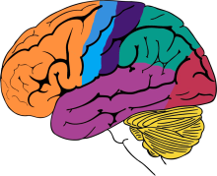
Introduction
This project falls under the category of neurodiversity. It is designed to help people who think differently than others. Some have their own preference of communication with other people such as communicating through morse code.

Slide 5

What is needed to solve the problem
Design a product that makes individuals more comfortable communicate with other people

Slide 6

Real World Safety Critical
Design must effectively communicate with others with high accuracy
Doing so would prevent any miscommunications to occur

Slide 7
Project Overview

Slide 8
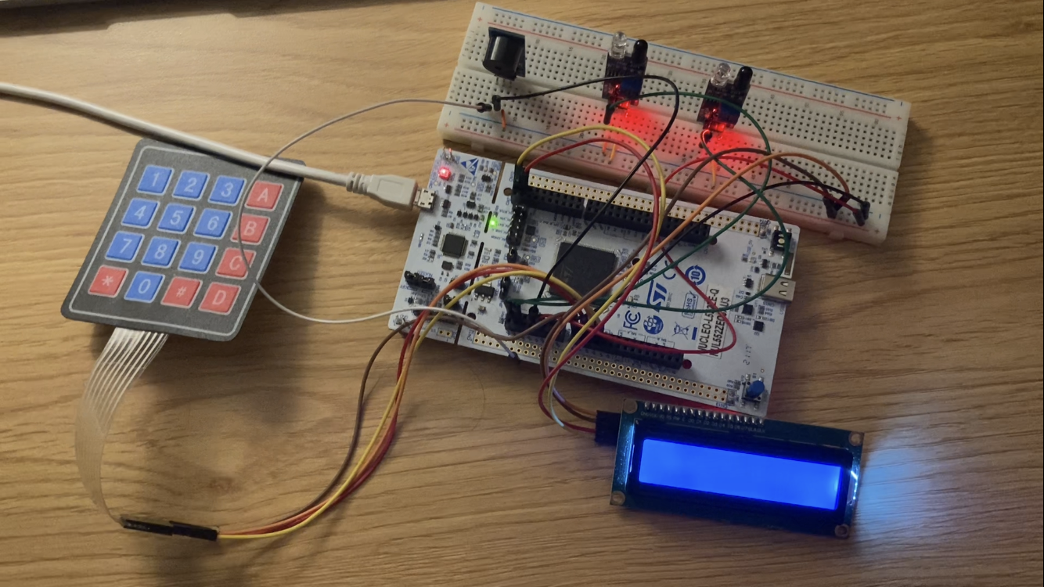
Project Overview
Objective: Translate morse code given from the user and display it on the LCD

Slide 9
Specifications
LCD must be used
At least two keys on the matrix keypad be used
A external input peripheral: IR sensor
A external output peripheral: Buzzer
Watchdog timer must be configured
Uses of Synchronization technique
At least 1 bitwise driver configuration
Critical Section protected
At least 1 interrupt
A task/thread incorporated

Slide 10
Features
Left IR sensor gives ‘.’ and right IR sensor gives ‘-’
With every input detected, the buzzer makes noise
With every input detected, the LCD will display user’s input
Keypad ‘1’ translate user input and display the character in the LCD
Keypad ‘2’ clear user input if they make a mistake
Keypad ‘3’ clear user input and translated code

Slide 11

Application
System can be used for:
Radio communication
Implement passwords for any locks
People who likes to communicate in morse code

Slide 12
Internal Features

Slide 13
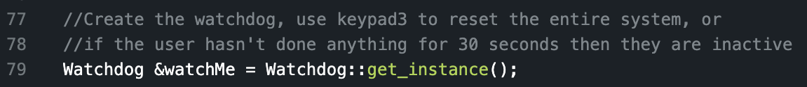
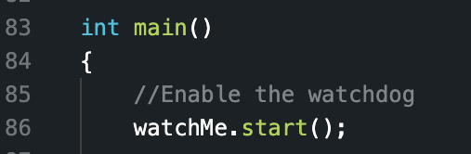
Watchdog
Watchdog is a way to resets the system in case of any failures or malfunction
Watchdog is implemented to reset the LCD if the system assumes the user is inactive for more than 30 seconds
Global:
Main:

Slide 14
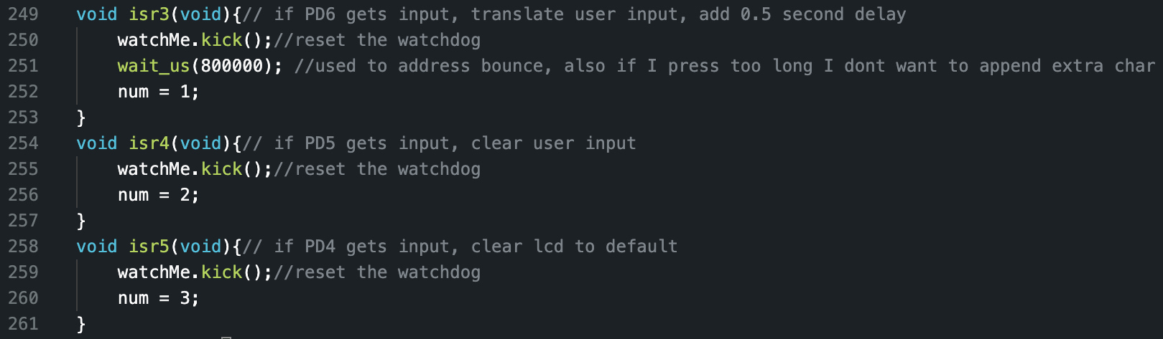
Watchdog
With every input, the function will reset the watchdog to assume user is still using the system

Slide 15
Synchronization Technique
A synchronization technique is a way to have multiple threads running simultaneously cooperate to each other.
Mutex is used in this project, it allows multiple thread to take turns in sharing resources

Slide 16
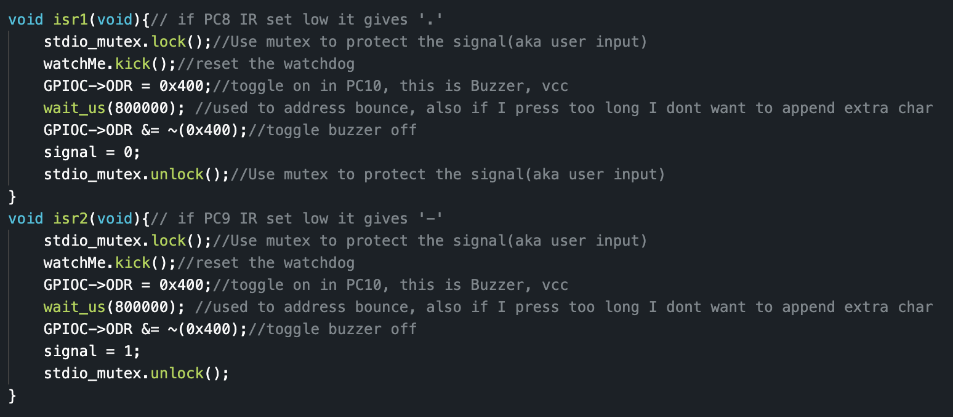
Synchronization Technique
Mutexes are used on the IR sensors so it can have access to the signal variable one at a time.
It doesn’t confuses what to put in for the user input

Slide 17
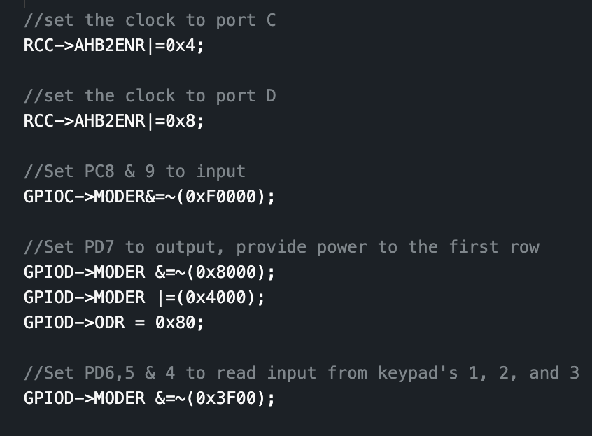
Bitwise Driver
Bitwise driver is controlling the bits in the microcontroller that makes the pins act a specific way
The main program changes specific pins to read an input and provide an output
Below here makes one of the pin to provide voltage

Slide 18
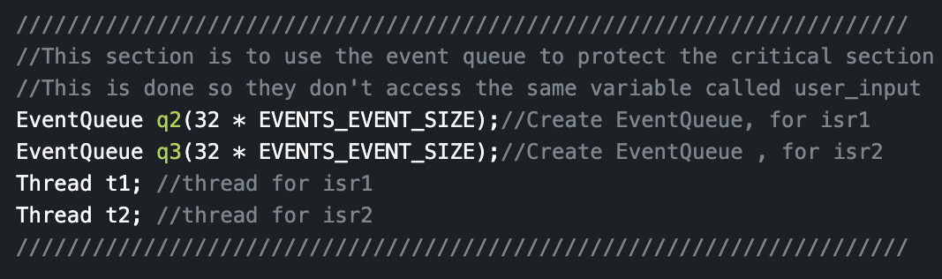
Protect The Critical Section
Critical section is protected by using an EventQueue that allows synchronization between multiple threads
EventQueue is used for the IR sensors

Slide 19
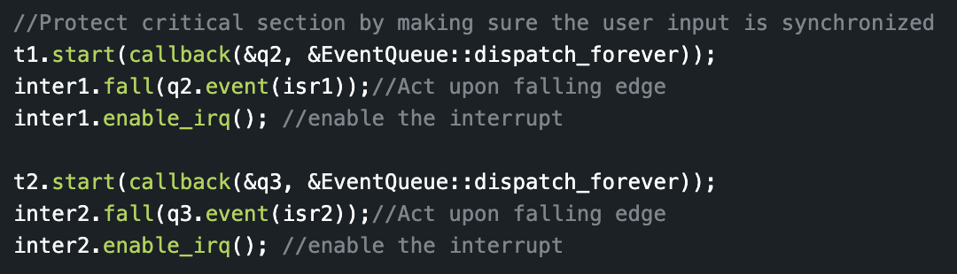
Protect The Critical Section
By using EventQueue it’s to ensure that any inputs given from the IRs will be safe and won’t mess up the shared resources. In this case that would be the signal and user_input global variables
Main code:

Slide 20
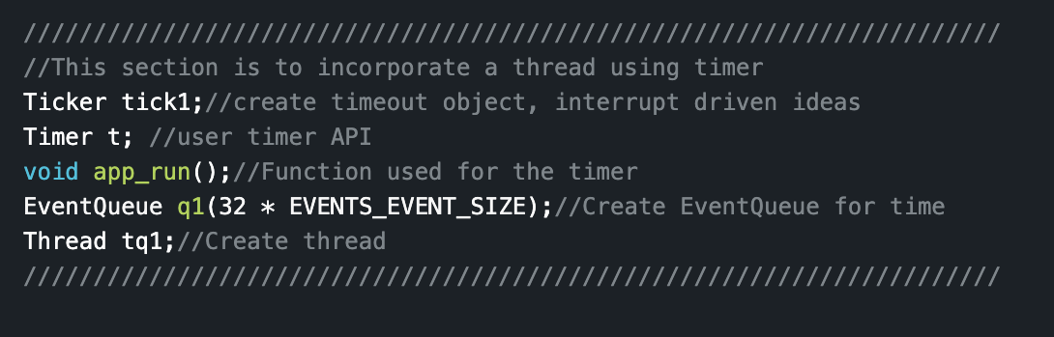
Thread/Task Incorporated
A thread/task having a program do another task in parallel with the main program or main thread
The thread is used to print in serial monitor how long the program has been running for using the timer API

Slide 21
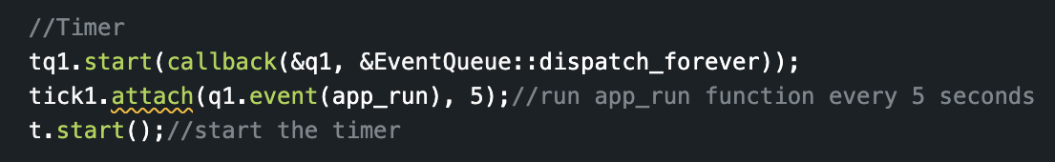
Thread/Task Incorporated
In main:
The function that is called every 5 seconds

Slide 22
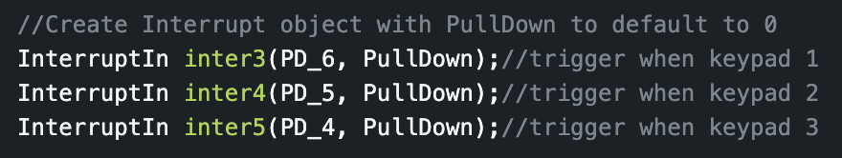
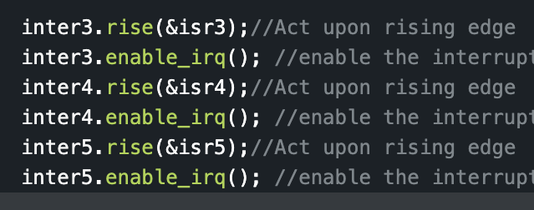
Interrupts
An interrupt is when the system sees a certain event, it halts the main program and do it’s own thing. Once the task is done, it returns back to the main program.
Interrupts is used on PD6, 7, or 8. These pins will trigger when it notices a rising edge.
Global:
Main:

Slide 23
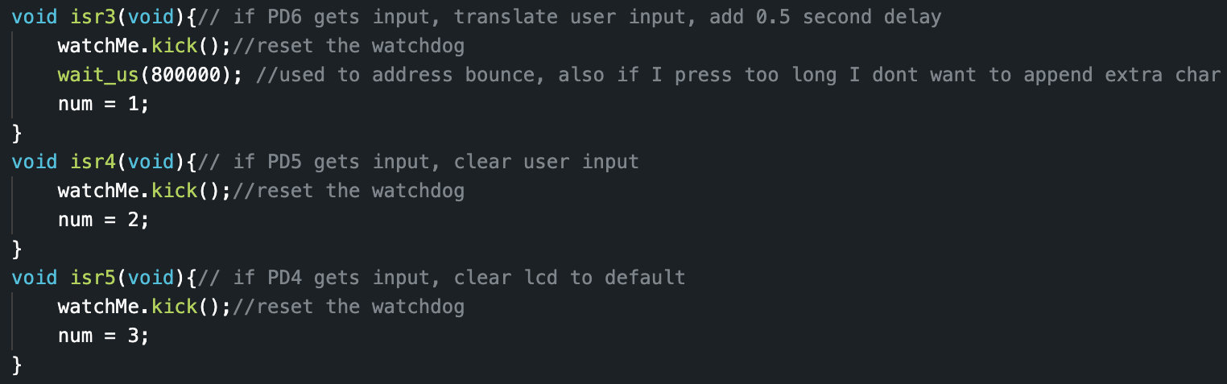
Interrupts
Functions that will call when an interrupt occurs

Slide 24
Development Timeline
11/7/22
11/20/22
11/25/22
12/6/22
12/14/22
Start
Peripherals
Program created
Functionality
Requirement met
The day project 3 was assigned
Learned how to use an IR sensor and a buzzer
A proper code was made to somewhat function correctly
The code works perfectly as intended however, not all project requirements have been met
Watchdog timer, Mutexes, thread/task, and critical section protection successfully implemented into the project

Slide 25
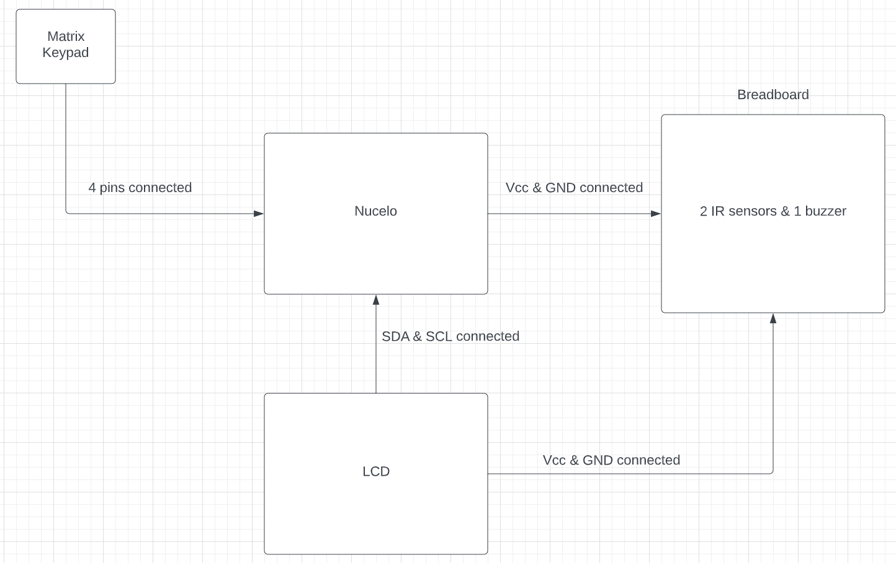
Block Diagram

Slide 26
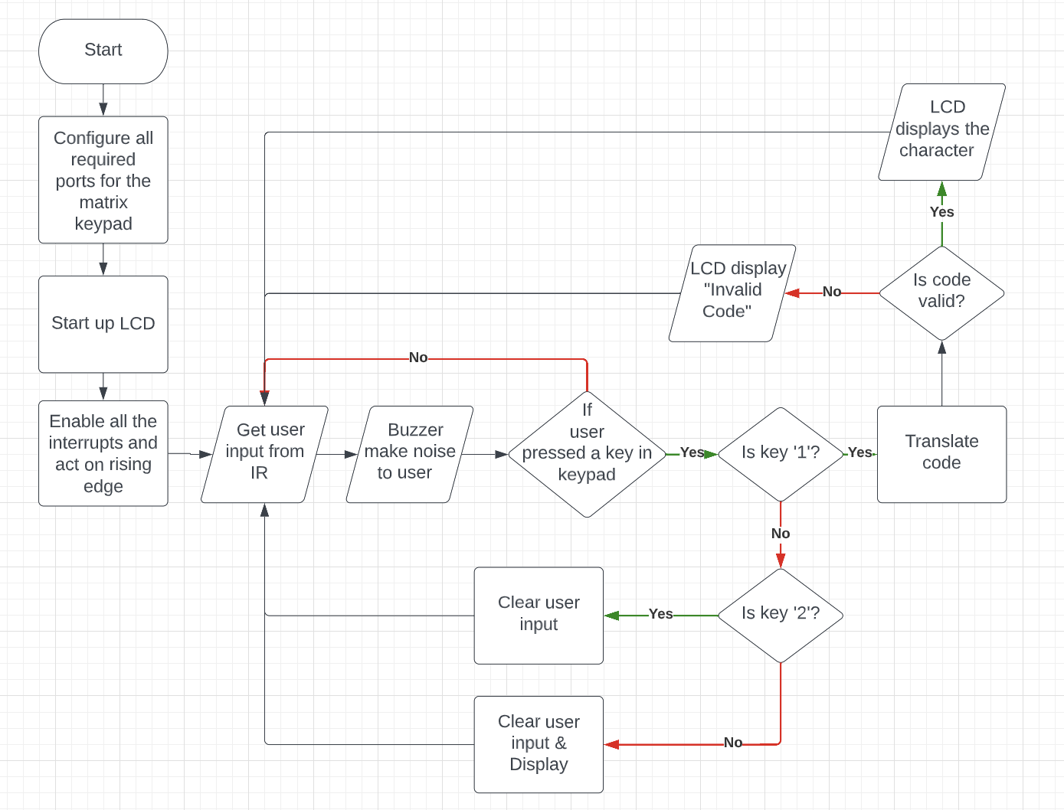
Diagram of System
Flowchart ->

Slide 27
Bill of Materials
Component | Quantity | Purpose | Additional Notes
LCD | 1 | Display text to user | 1602 Model
Nucelo | 1 | Run the program and make connections to other peripherals | L4R5ZI Model
Matrix Keypad | 1 | Controls LCD display | 4x4 Keypad
Breadboard | 1 | Placeholder for peripherals
Jumper Wires | 120 | Make Connections | Require some male to female & female to male wires
LED | 1 | Display Input
Resistor | 1 | Prevent LED to blow up
Buzzer | 1 | Make noise
IR | 1 | Take user input

Slide 28
User Instructions

Slide 29
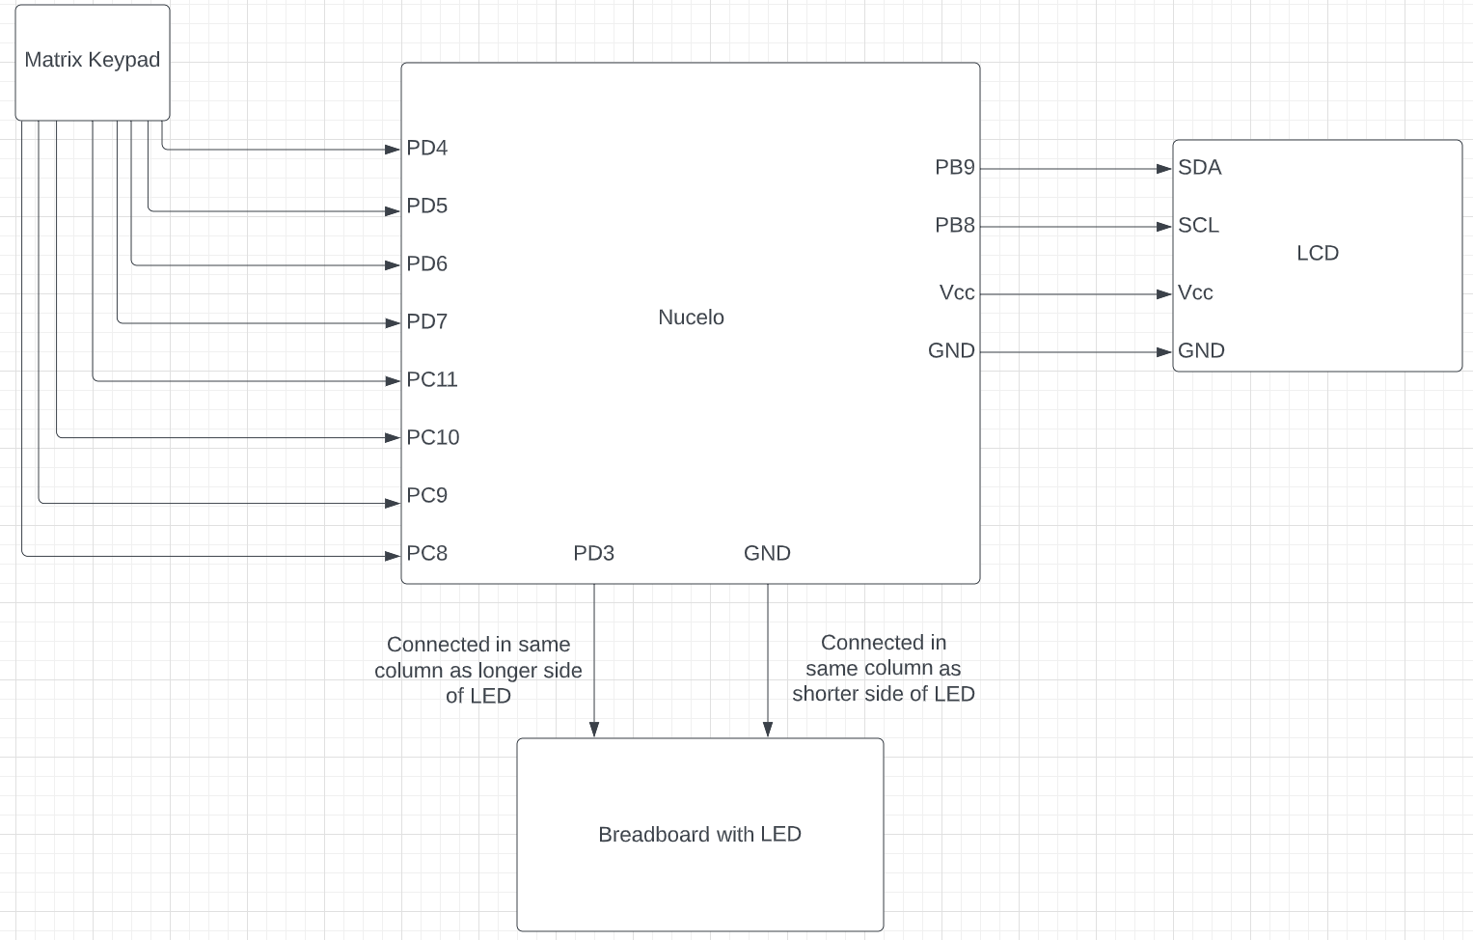
Schematic
Notes:
Show breadboard, LCD, LED, and nucleo connections

Slide 30
Instruction to Build
1. Connect first row pin of matrix keypad to PD7 using jumper wires.
2. Connect column one pin to PD6, column two pin to PD5, and column three pin to PD4 using jumper wires.
3. Connect 5V from the nucleo to the breadboard's red power rail.
4. Connect the GND from the nucelo to the breadboard's blue power rail.
5. Connect the LCD's SDA to PB9, and SCL to PB8. Finally connect the the GND to the breadboard's blue power rail and Vcc to the red power rail.
6. Place the buzzer on the breadboard. Connect Vcc to PD10, it's I/O to PC11, and it's GND to blue power rail.
7. Place two IR sensors on the breadboard. Connect both IR sensor's GND to blue power rail and Vcc to red power rail.
8. Connect the left IR sensor's OUT to PC8 and the right sensor to PC9.

Slide 31
Instruction to Use
Left IR gives ‘.’
Right IR gives ‘-’
1 on keypad translates code
2 on keypad clears input
3 on keypad clears input and message

Slide 32
Test Plan
Things to Test | Inputs | Outcome
IR sensors | Hover finger around left IR twice and the right IR one | LCD displays “..-”
Buzzer | Hover finger around IR sensors as many times as you like | Buzzer should make a noise for every input
Keypad 1 | Give inputs “.---” Press 1 Give inputs “-.--” Press 1 | LCD displays “JY”
Keypad 2 | Give any inputs Press 2 | LCD should show user input, then the user input screen is cleared
Keypad 3 | Give inputs “.-” Press 1 Give inputs “...” Press 3 | LCD should show message as “A” and user input as “...” Once 3 is pressed it clears message and user input

Slide 33
Result

Slide 34
Result
All requirements were successfully implemented into the project
IR sensor have taken in user input correctly
Program successfully translated morse code
Results shown properly in the LCD

Slide 35
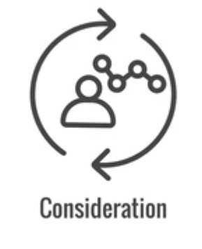
Future Considerations
Sometimes the program ignores the IR sensor
1 IR sensor would be more appropriate

Slide 36

Considerations - General Improvement
Implementation on muxes, and Eventqueue improve the program:
Made IR sensor pickup user input faster
Code ignores user input a lot less but it still happens

Slide 37
References
https://www.geeksforgeeks.org/map-associative-containers-the-c-standard-template-library-stl/
https://cplusplus.com/reference/map/map/find/

